Slide 1

WHO ARE WE?
WE ARE THE HIRAM HORNETS!
25-26 CLASS PRESENTATIONS

Slide 2

Who’s Who at HHS?
Mr. Hodge – Principal
Mrs. Byrne – Assistant Principal (Students A-C)
Mr. Wallace – Assistant Principal (Students D-H)
Ms. Stubbs – Assistant Principal (Students I-M)
Mr. Tittle – Assistant Principal (Students N-S)
Dr. Sublett – Assistant Principal (Students T-Z)
Ms. Gray – Evaluation Assessment Coordinator
Deputy Whitley – School Resource Officer
Officer Wilson - School Safety Officer
Mrs. Wilson – School Safety Guard

Slide 3
HHS Counselors are Rock Stars!
Mrs. Jackson– Students with last name “A – C”
Mrs. Brooks– Students with last name “D - H”
Ms. Hrisak – Student with last name “I - M“
Mr. Pearson – Students with last name “N – S”
Dr. Walker – Students with last name “T – Z”
Mrs. Downey – Guidance Office Manager
https://hiramschoolcounsel.wixsite.com/hhscounseling

Slide 4
Steps to Academic Success
Build Relationship with Teacher
  Ask questions when you do not understand
Do the work & submit the work that is assigned
  Extra Credit doesn’t exist in the real world/on a job/or in college. You are not rewarded with extra if you cannot do the job/task that is assigned to you.
Attend Tutoring Sessions (Before/After School/Hornet Time)
Surround yourself with other peers that are doing well
You must ADVOCATE for your success

Slide 5
HORNET TIME
Hornet Time is Hiram’s Intervention/Enrichment Block that provides opportunities during the school day for students to get extra help/support in a course, make up missed assignments/assessments, explore new concepts through enrichment, prepare for AP Exams & attend counseling sessions
Students can attend club meeting or athletic team meetings if they are scheduled & ALL classes are passing with grade of 80% or higher.
Hornet Time – Wednesdays between 3rd & 4th Blocks – 1:05p – 2:05p
  Fall Semester – September – November
  Spring Semester – February – April
More information will be coming the coming weeks

Slide 6

Class Support and Tutoring

Slide 7
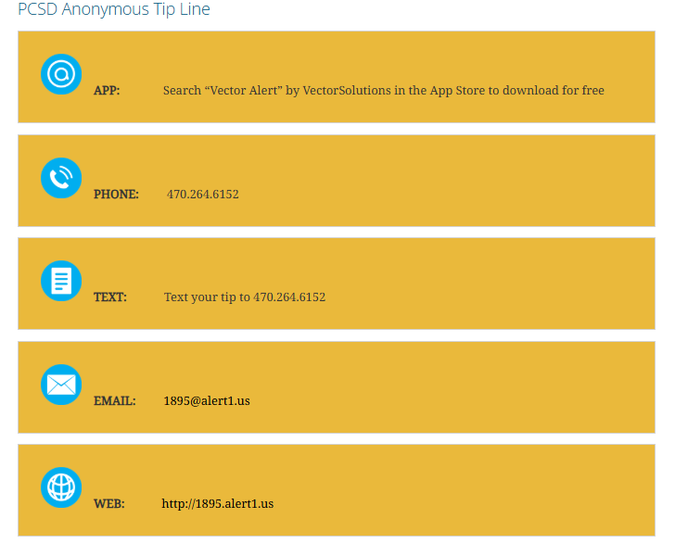

Slide 8
Operational/Safety Procedures
ONLY 1 student will be allowed out of your class at a time.
(Use the Restroom/Vending Machines on your Hall only)
Counselor Request: Students will need to schedule an appointment with their assigned counselors using the QR Code posted in classrooms and around the building.
For Emergency Only – Counselor will come to the classroom to assist you
During afternoon dismissal; we will dismiss by hallways/area

Slide 9
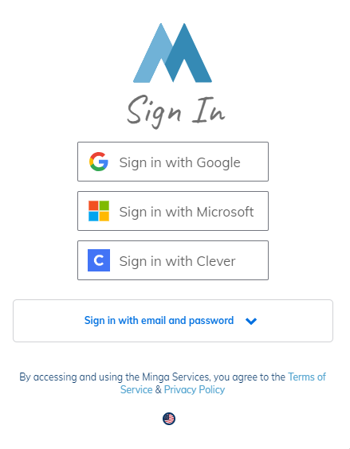
MINGA
Digital Hall & Tardy Pass System
Download the App to your personal device
  Use your Paulding Co. Login
You can also access through your school issued laptop
Hall Pass – 6 minutes - Restroom
Tardy QR Code – Tardy to School & Class

Slide 10
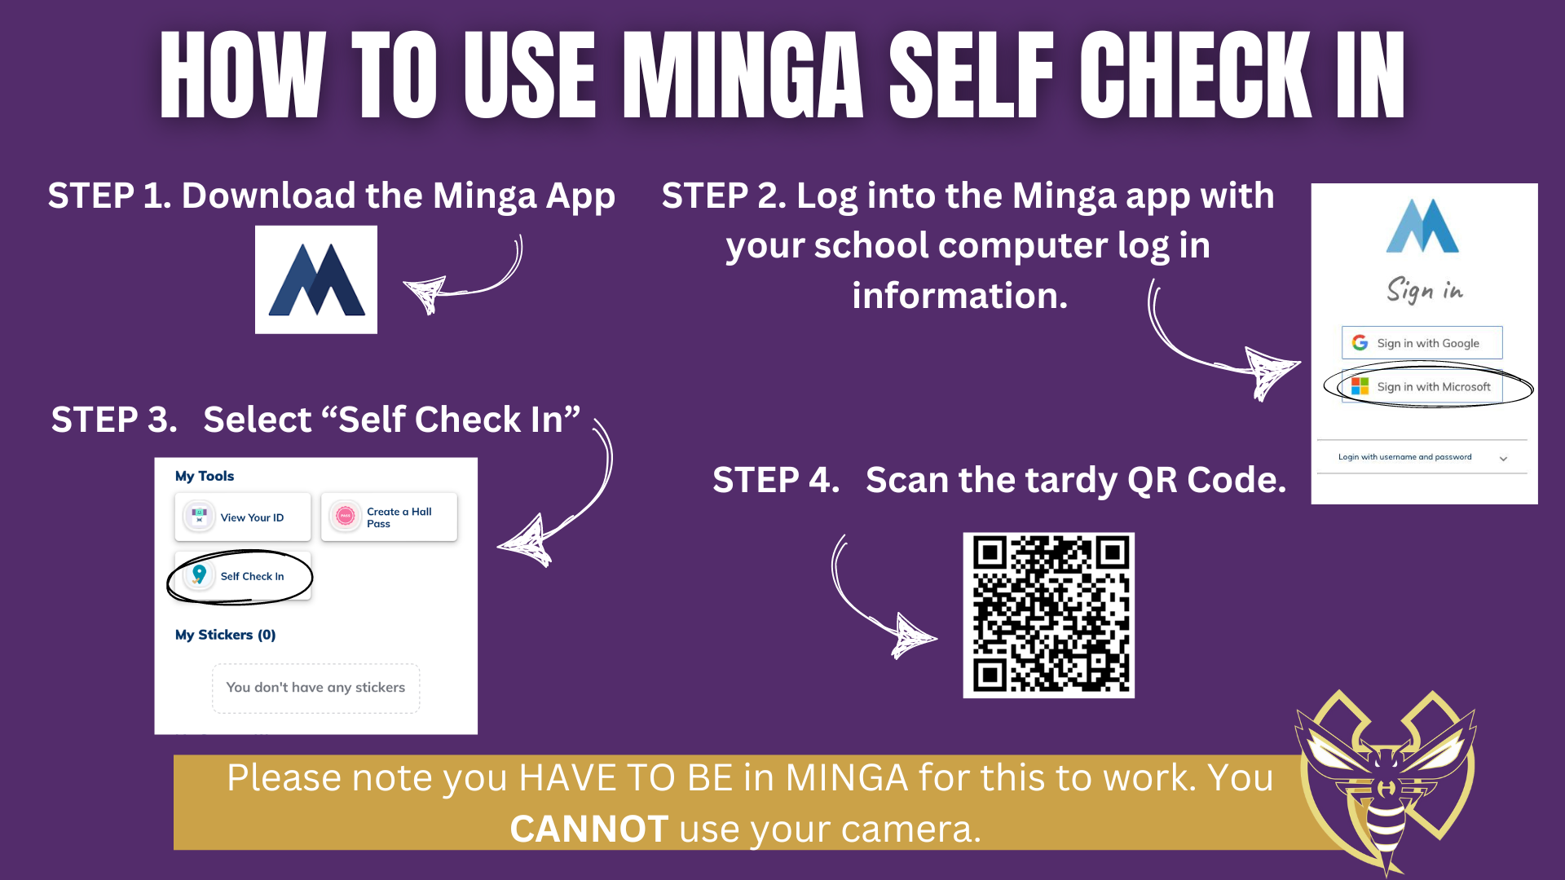

Slide 11
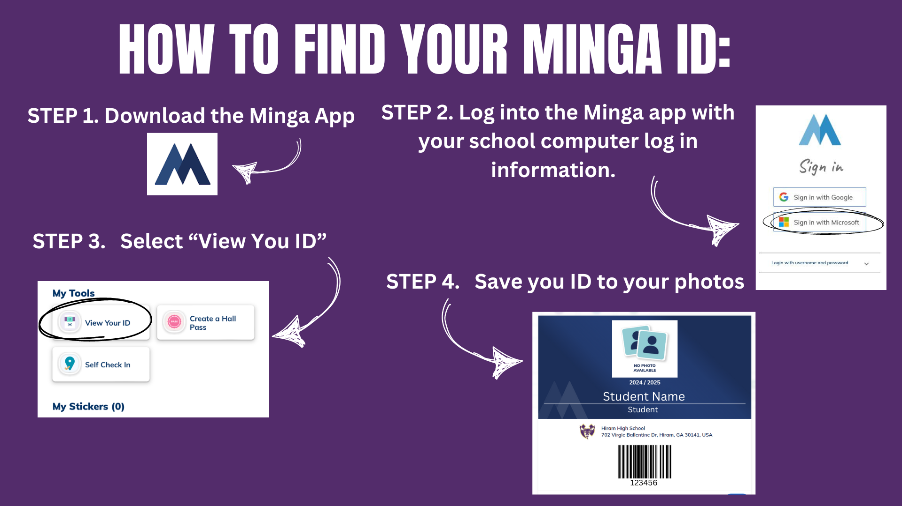

Slide 12
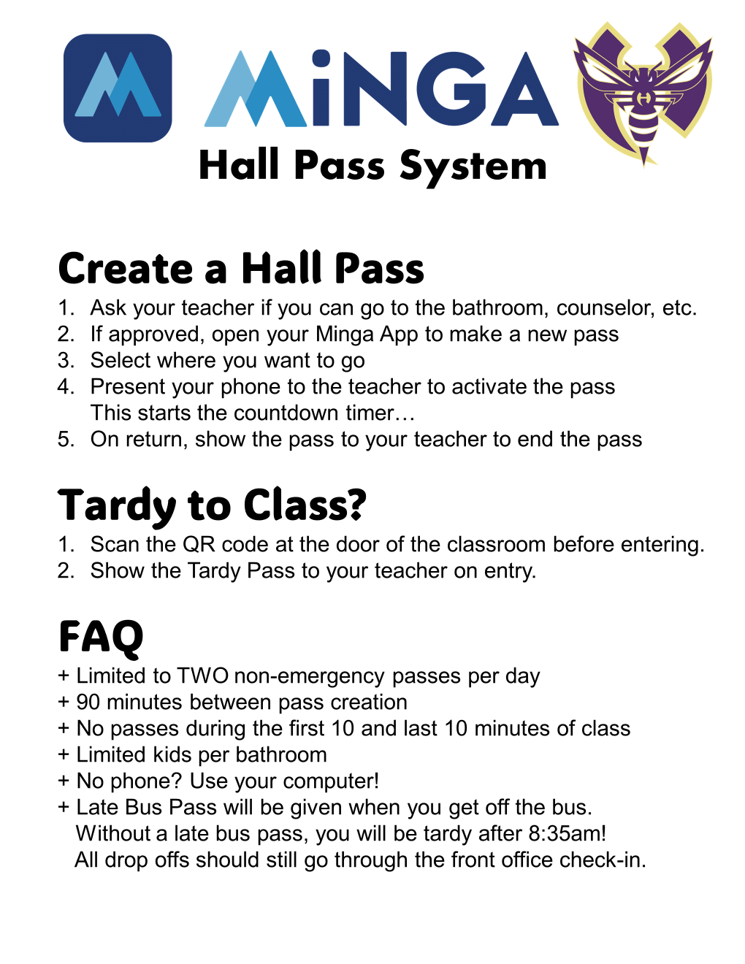

Slide 13

HHS 25-26 Dress Code
Masks are allowed but not mandated
Pants MUST fit appropriately
Shirts MUST fit appropriately – No cropped/cut off tops unless you have a tank/cami on under it, arm holes must fit appropriately
Rips/Holes in jeans/pants are fine as long as they go no higher than mid thigh – higher than that requires shorts or legging under the jeans/pants
Shorts/skirts/dresses – must come to mid-thigh
HATS are allowed, BUT no hoods, no durags, head scarfs, bonnets, and no bandanas
Clothing MAY NOT depict, advertise or advocate:
  the use of alcohol, tobacco, marijuana or other controlled substances
  pornography, nudity or sexual acts
  hate speech targeting groups based on race, ethnicity, gender, sexual orientation, gender identity, religious affiliation or any other protected groups.

Slide 14


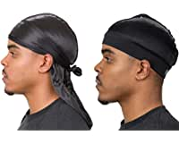
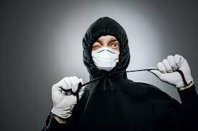


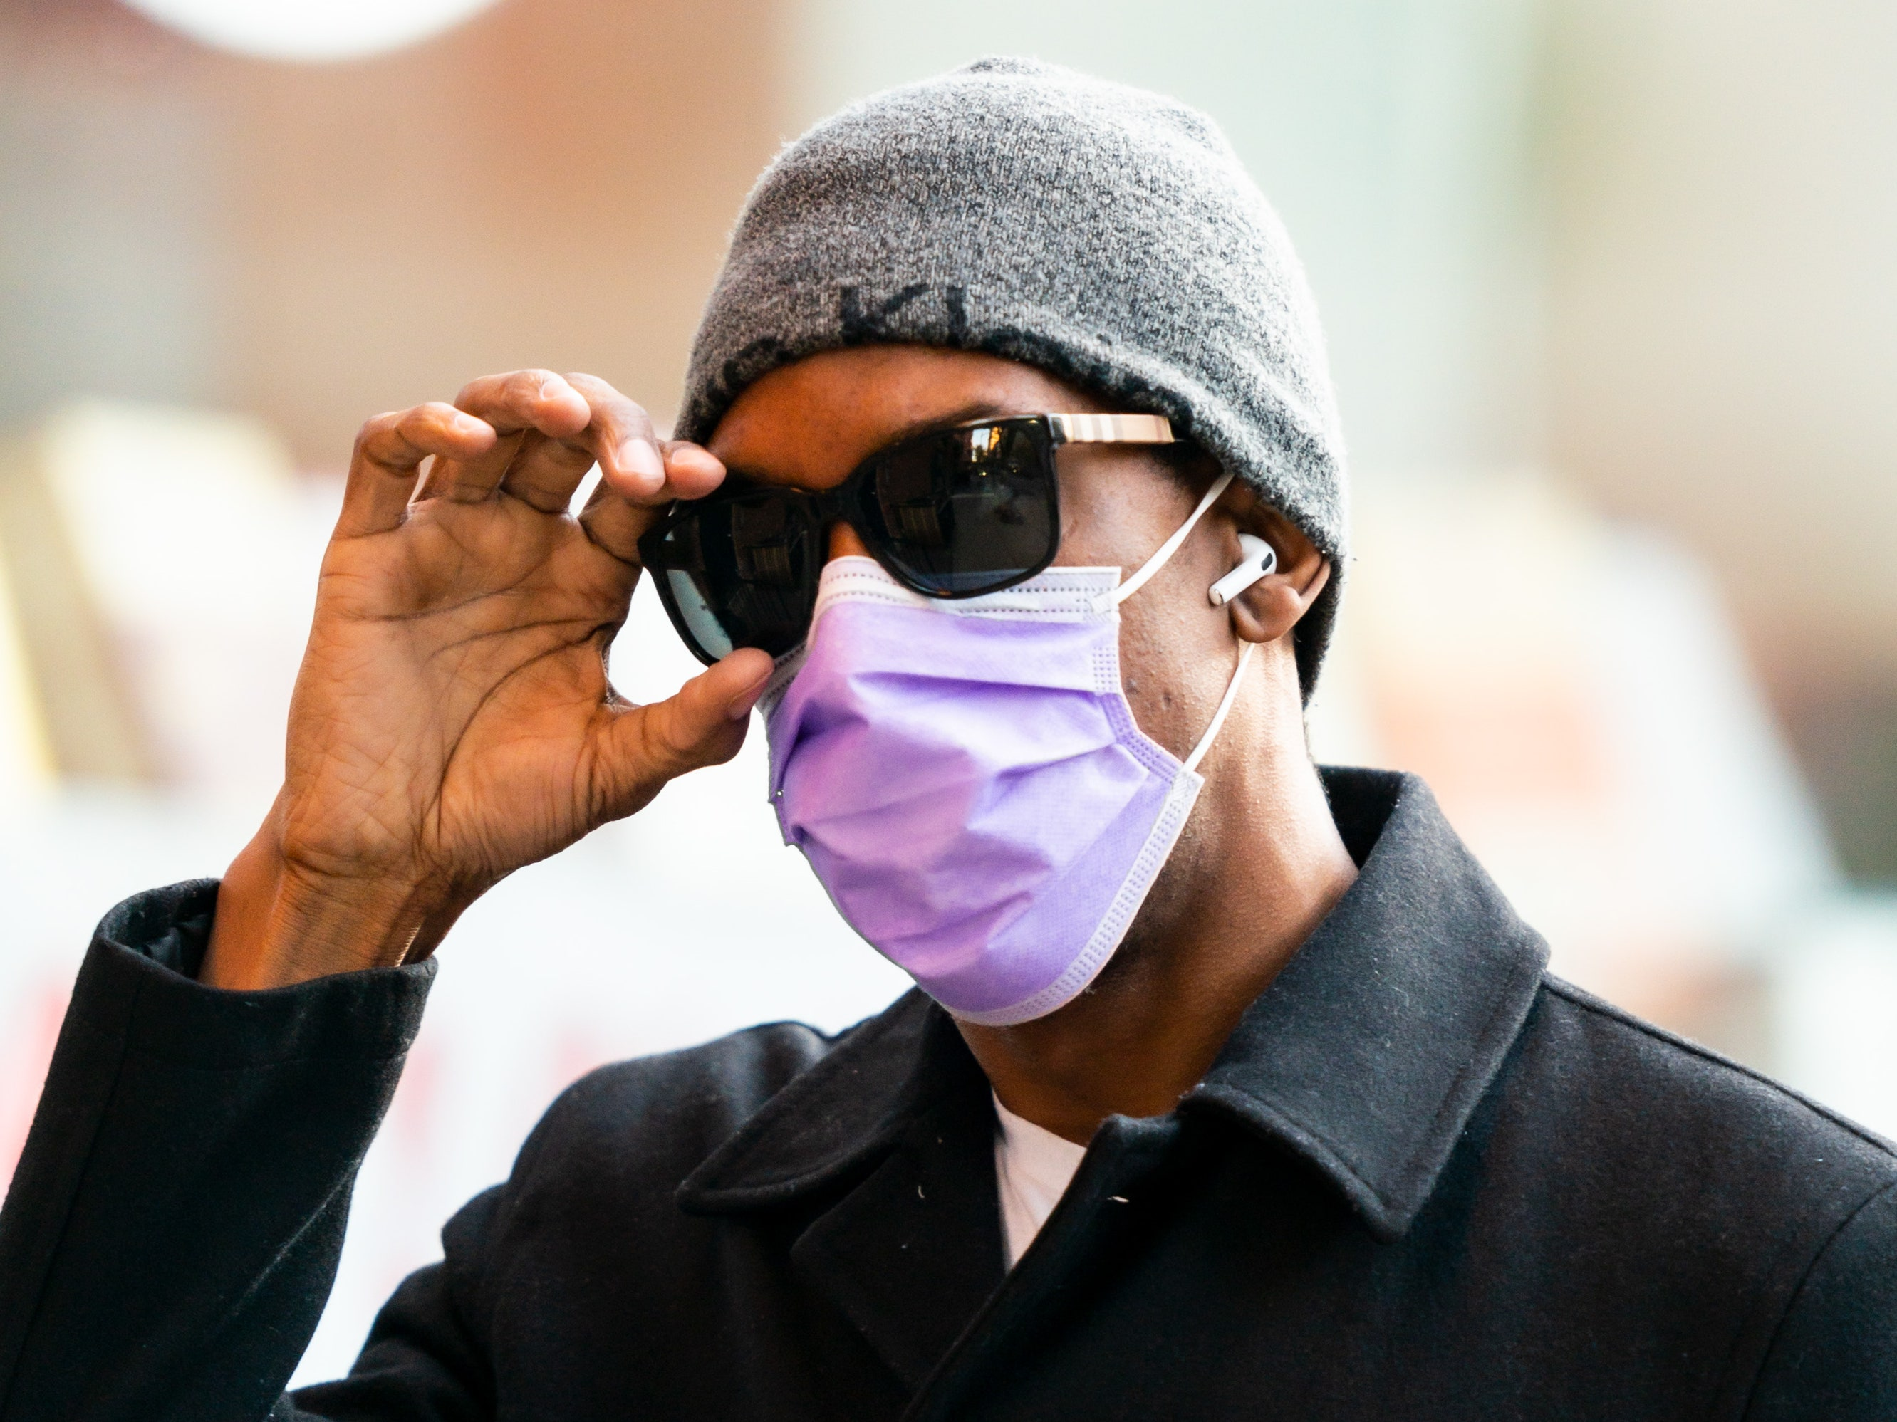

Dress Code
Not Appropriate For Hiram HS
**The administration reserves the right to determine if items of clothing are too casual, too revealing, disruptive, or distracting within the school environment**

Slide 15
**The administration reserves the right to determine if items of clothing are too casual, too revealing, disruptive, or distracting within the school environment**

Slide 16
What happens when I do not follow Dress Code?
1st offense…Student will have an opportunity to call home for a change of clothes – if no change is brought, student will stay in ISS for the remainder of the day
2nd offense…Student will have an opportunity to call home for a change of clothes – if no change is brought, student will stay in ISS for the remainder of the day
3rd offense…Student will report to ISS for the remainder of the day.
4th offense or more…Student will report to ISS and will receive a discipline referral for insubordination. Student may receive further consequences based on discipline history.

Slide 17
NO DRAMA!
We do NOT have time to deal with these issues at HHS – so DO NOT engage in them!
Drugs of ANY kind
Alcohol
Weapons
Gangs/gang paraphernalia (this includes ANY type of bandana)
Cultural insensitivity and/or disrespect
Fighting
Bullying (physical, verbal, cyber)
ANY Drama that disrupts the school

Slide 18
Resolving Conflict
Manage your emotions
  25 seconds of not regulating your emotions could cost you 25 yrs. to Life
Ignore negative comments about you
  You know who you are & you know your truth, be comfortable in your own skin
Eliminate/Reduce your Social Media usage, Text Messages or Listening to “He/She said”
  You do not have to befriend everyone nor be concerned who does not like you
  Hard to understand/read people’s emotions through text communication
Communicate with trusted adults in the building to mediate issues that you are having
  Counselors & Administrators are available to help mediate conflict

Slide 19
Cell Phone/Electronic Devices
Cell Phones may be used between classes and during lunch
You may only use cell phones during class time with teacher permission for academic purposes
Cell phones cannot be used to distribute any type of inappropriate materials which includes but isn’t limited to:
  Profane, vulgar, lewd, obscene, offensive, indecent, pornographic, or threatening material
  Advocating illegal acts, dangerous acts, or advocating violence
  Causing a disruption to the school or its normal operations
  Is harmful to minors as defined by Children’s Internet Protection Act 21
    Link in Student Handbook: https://www.paulding.k12.ga.us/Page/21049

Slide 20
Cell Phone/Electronic Devices
Students shall not use audio or visual recording devices without the permission of a school administrator. This includes but is not limited to using recording devices to video or record misbehaviors or to violate the privacy of others.
Students shall not use personal technology devices to access chat rooms/social networking sites such as Facebook, Twitter or Instagram during the school day that causes disruption to the learning environment

Slide 21
1:1 Technology
Each student will have the ability receive their district issued laptop. Students are not allowed to use their own Personal devices from Home.
Receiving your own laptop also comes with responsibility.
Be Prepared to:
  Update your device weekly.
  Charge your device daily.
  Bring your device EVERYDAY!
  Take care of your personal device.

Slide 22
Searches on Campus
The school has the legal right and responsibility to maintain a safe and orderly environment. Where, in the opinion of the school administration, there is suspicion that the school rules or legal codes are or have been violated, all personal items can be searched, including but not limited to person, purse, bags, clothing, lockers and vehicles. Please do not put us in the position to have to search you or your belongings!

Slide 23
Theft on Campus
We cannot stress enough the importance of keeping all personal belongings either with you at all times or locked away safely in your locker or car.
Do not leave anything you value unattended for any amount of time or someone will take it.
Do NOT leave your items unlocked in the locker room!
The school is not responsible for lost or stolen items!

Slide 24
Arrivals & Departures
Doors are unlocked at 7:55 am each morning. Students report to media center/Café until 8:30 am
At 8:00 am, students may get breakfast and then report to their Advisement/1st Block class.
CLASS STARTS @ 8:35AM
When students are dismissed, they must:
  Go to their bus or car in the student parking lot
  Go to their ride in the front loop of the school
  Go to their specific extra-curricular activity
  Go to their specific tutoring
ALL students in the building after 3:40 pm MUST be with a teacher/staff member.

Slide 25
Attendance
Exam Exemptions are in place – 5 or more unexcused absences cancels your chance to exempt
If you are out sick, a parent note will excuse it (You get 5 Parent Notes per semester)
Students can turn in a parent note for missing school due to illness
Notes are turned in at the attendance window in the front of the school
Students who are late to school after 9am MUST check in through the front office.
Students have 5 minutes to get from class to class – that is plenty of time to get from one class to another

Slide 26
Attendance
All parent/doctor notes, early check out notes should be turned into the attendance window by 8:35 each morning
Unexcused Tardies:
1st -3rd Tardy: Student Warning
4th-6th Tardy: Lunch Detention
7th & 8th Tardy: Saturday School
9-11th Tardy: 1 day ISS each time
12th -13th Tardy: 2 days ISS each time
14th or more: OSS each time
If you are late to class 1st - 4th Block you scan the QR Code located strategically throughout the school & by teacher door
Any tardies after 9am check-in Front Office.

Slide 27
Certificate of Attendance/Drivers License
Items Department of Drivers Services will take
  Copy of Class Schedule – Infinite Campus
  Copy of Student ID – Once you take Class Photo
  Copy Unofficial Transcript – Infinite Campus
  Copy of recent Grade Report – Infinite Campus
  STUDENT RESPONSIBILITY

Slide 28
Do You Drive to School?
Remember that you can lose your parking if you have:
  5 or more unexcused absences
  3 or more discipline referrals
  5 or more unexcused tardies to school or unexcused check outs
  Park in your assigned space
YOU WILL NOT RECEIVE A REFUND FOR PARKING IF YOU LOSE IT!

Slide 29
Clubs & Organizations
Get Involved! High School is what YOU make it!
Beta Club
National Honor Society
Chick-Fil-A Leadership Academy
Drama Club
FBLA / HOSA / TSA / SkillsUSA
Garden Club
HOPE Hispanic Organization
Student Leadership Team
And Many More! Check out the full list on school website under Student Resources!

Slide 30
Extra! Extra! Did You Know?
Get Involved! High School is what YOU make it!
Fall Sports | Winter Sports | Spring Sports
Football | Basketball | Golf
Cross Country | Wrestling | Tennis
Cheerleading (Football) | Swimming | Soccer
Softball | Rifle | Track
Volleyball (Girls Only) | Cheerleading (Basketball) | Baseball
Flag Football (Girls Only)
E-Sports

Slide 31

CTAE – Start Your Career Now!
Career Pathways Available at HHS
Financial Services
Cosmetology
Graphic Design
JROTC
Criminal Investigations
Automotive
Engineering
Certified Medical Assistant
Sports Medicine
Audio/Video and Film

Slide 32

Advanced Placement Courses
Benefits of AP Courses
To Prepare You for College Level Courses
To Save You Time and Money in College
To Boost Your GPA
To Get a Head Start on College Requirements
Overall, Strengthens Your Transcript

Slide 33
Exam Exemptions – Updated for 25-26
A student with a grade of 80 or above in a class at the end of the semester
A student with FIVE (5) or less unexcused absences
A student with FOUR (4) or less unexcused tardies to the specific class they wish to exempt
A student may exempt a maximum of TWO (2) exams total per semester
A student may exempt a maximum of ONE (1) core class per semester (Math, English, Science, Social Studies, World Language) and ONE (1) elective.
A Student taking an AP Class and who is registered to take the AP Exam may exempt that AP final as an additional exemption.
A Student completing a CTAE Pathway and Passing the EOPA for that class may exempt that CTAE final as an additional exemption.
Exam Exemptions forms ARE NOT accepted past the due date established by the school. There are NO exceptions for this policy – exam exemptions are a privilege and as such, students must take full responsibility in getting the signed exemption forms turned in by the due date.
Exemptions are only conducted for semester final exam days in December and May. Courses that are offered for less than a semester are not exemptible during the mid-semester final exam (i.e. Health/Personal Fitness, Economics, Government, etc.).

Slide 34
#NOCEILINGS

Slide 35

WHY ARE
You HERE???

